Slide 1

GAMECO MARKET SALES ANALYSIS
Presented by Xuan Nguyen

Slide 2
OVERVIEW
Goal:
Develop an understanding of the video game market sales to ensure GameCo maximizes return on investment
Assumptions:
GameCo’s current understanding around video game sales assume that sales across regions have stayed the same over the years.
Areas of Observation:
This analysis will observe trends over time in accordance with:
How sales figures varied between regions
Whether certain genres are more popular than others
Which publishers are the main competitors
Whether games have increased or decreased in popularity

Slide 3
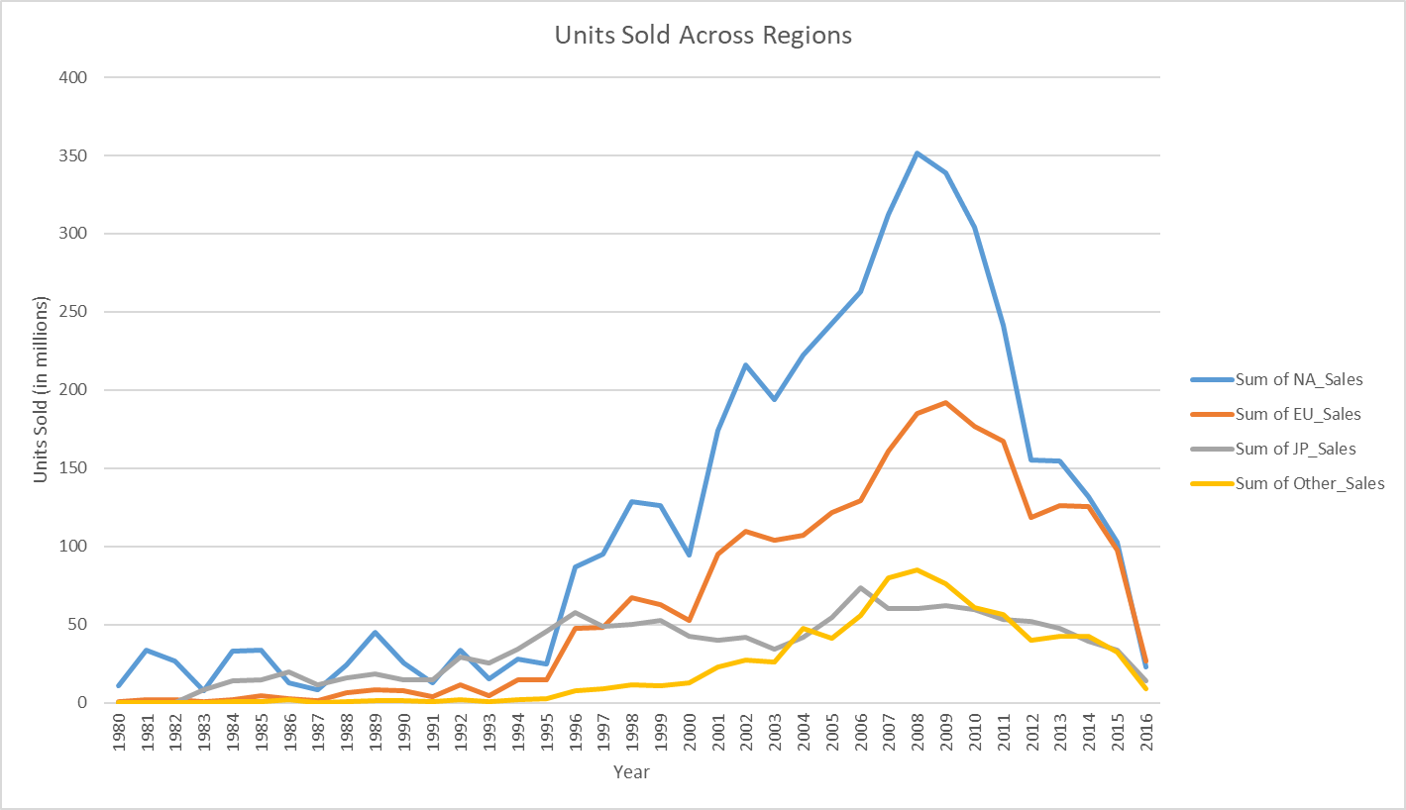
SALES ANALYSIS
North America has dominated the market in sales over the years
There have been a gradual increase in sales up to the late 2000s
Each market region peaked in the late 2000s, specifically 2008 for North America, 2009 for Europe, and 2006 for Japan
There is a sharp decline in sales since the late 2000s, which can be attributed to the introduction of digital sales

Slide 4
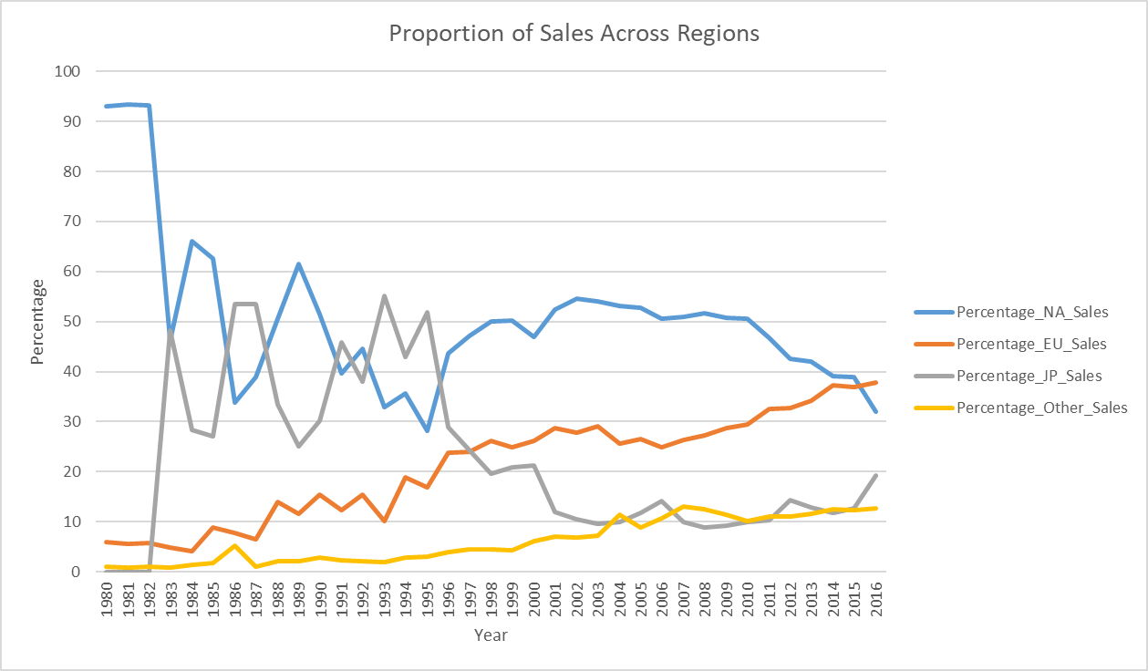
PROPORTION OF SALES
North America and Japan’s sales fluctuated over time
Europe and Other regions shows a steady incline in sales
North America had a strong market sales until 2015, when Europe surpassed it
North America and Japan become mirror images of each other starting in 1996

Slide 5
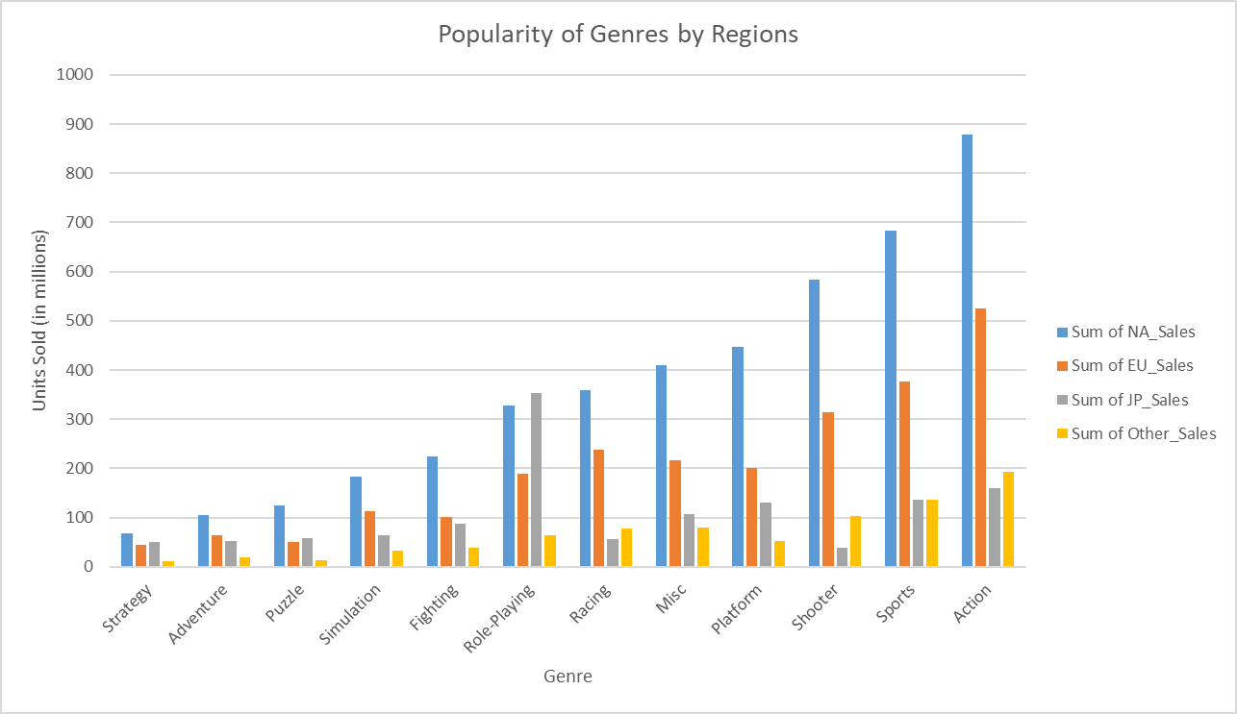
GENRE POPULARITY
North America, Europe, and Other shares the same top 3 genres: Action, Sports, Shooter
Japan’s top genre is role-playing, followed by Action and Sports

Slide 6
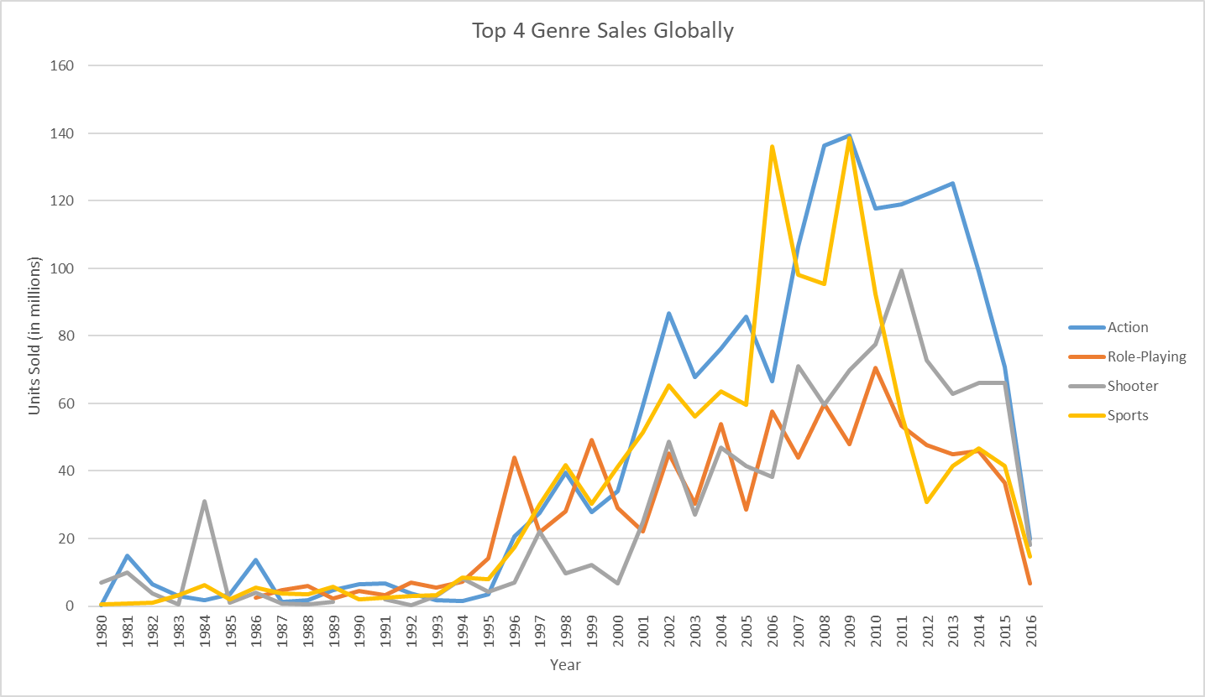
GENRE SALES
Top 4 genre sales show a steady increase in sales up until the late 2000s
The decline in sales can be attributed to the introduction of digital sales

Slide 7
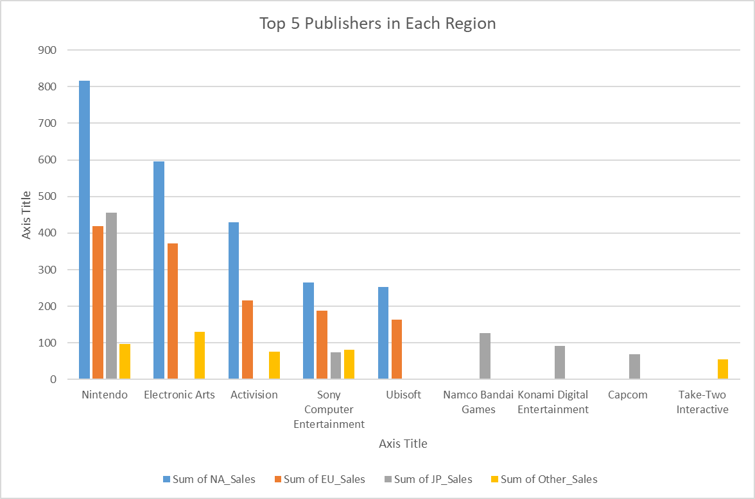
TOP 5 PUBLISHERS
Nintendo dominates the market in all regions except in Other where it is 2nd
North America and Europe shares the same top 5 publishers
Japan only shares Nintendo with the other regions
Other shares the top 4 with North America and Europe

Slide 8
REVISED UNDERSTANDING
The analysis of the data set does not include digital sales, which can attribute to the decline in sales
Europe and Other regions shows a stable market for video game sales
North America, Europe, and Other regions shares the same top 3 popular genres
Nintendo has become the dominate publisher across all regions

Slide 9
RECOMMENDATIONS
Further analysis should be conducted to determine if the introduction of digital sales balances out the decline in sales
Executives should plan for a platform in which they can sell digital games.
Partner with Nintendo to provide the highest marketing abilities for the release of the games
Ensure adequate games in the respective popular genres for each region
Provide a solid marketing plan for Europe and Other regions to ensure the stability of market sales

